Slide 1

Django Basic
“Hello World” in Django

Slide 2
Information
Agenda
System
01
PyCharm & Django Installation
Starting with PyCharm and Django
02
“Hello World” in Django
The starting point of Django

Slide 3
PyCharm & Django Installation
Starting with PyCharm and Django

Slide 4

For Installation
Use your university’s email address (xxx@hufs.ac.kr)
1. Download the academic version (free for students with academic email address)
  https://www.jetbrains.com/community/education/#students
2.(a). Anaconda (for the analytics purpose)
  https://www.anaconda.com/
2.(b). Python
  https://www.python.org/
Choose either Anaconda or Python for the installation. Using “Anaconda” is recommended.

Slide 5
There are two ways to install Django
Install using pip
  Django will be installed in the systemwide
Install Django in virtual environment
  Django will be installed in the particular project and will not affect other project.

Slide 6
Install Django using pip (in command prompt)
Run “Anaconda prompt”
If your distribution already has pip installed, you might need to update it if it’s outdated.
If you want to specify the Django version, you can type as follows.
If you just want to install the latest / upgraded version, you can just type Django
python –m pip install --upgrade pip
pip install django~=4.0
pip install django
pip install --upgrade django

Slide 7
Install Django in the Pycharm environment
Basically, Django has been included in Pycharm Professional Edition
Additional info or library can be added in the “Setting”

Slide 8
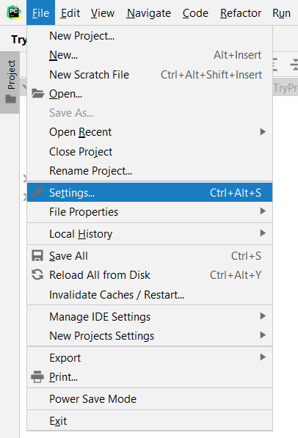
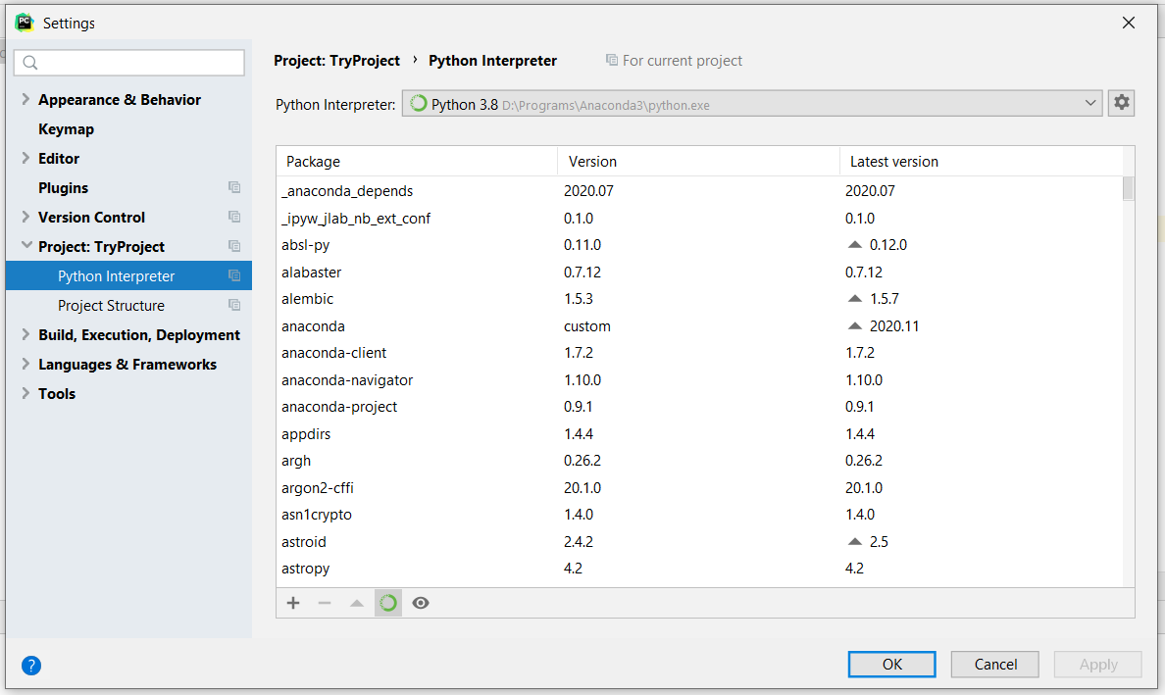
Install Django in the Pycharm environment

Slide 9
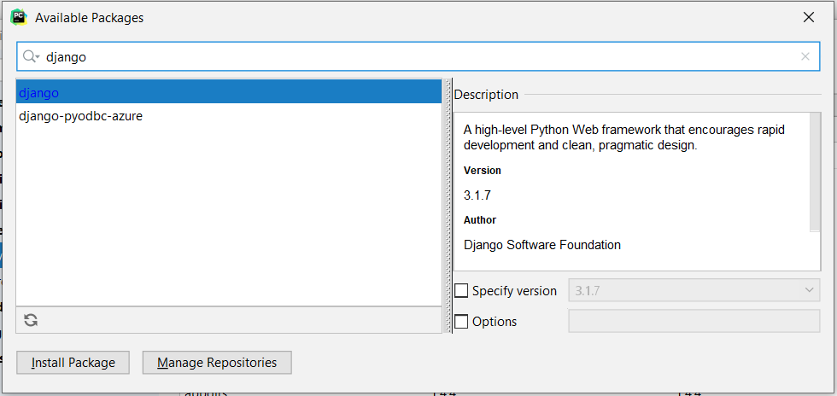
Install Django in the Pycharm environment
Install this Django if it does not exist

Slide 10
“Hello World” in Django
HTML in Django

Slide 11
Template Loading
Django provides a convenient and powerful API for loading templates from disk, with the goal of removing redundancy both in your template-loading calls and in your templates themselves.
In order to use this template-loading API, first you’ll need to tell the framework where you store your templates. The place to do this is in your settings file.

Slide 12
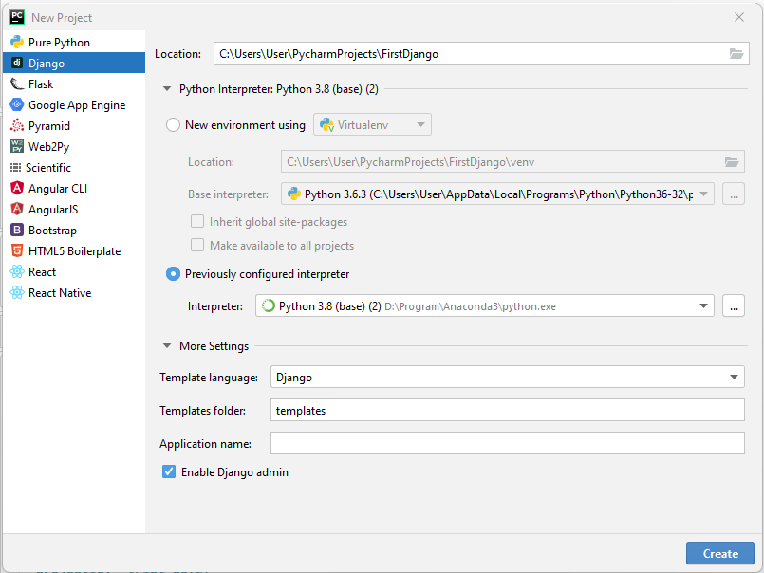
1st example
Let’s create a new project name: “FirstDjango“
If you are using PyCharm community edition, you need to build “virtual environment”
If you run PyCharm for the first time, find the existing interpreter. In my case, I will use the Python in Anaconda
You can redefine the “Templates folder”

Slide 13
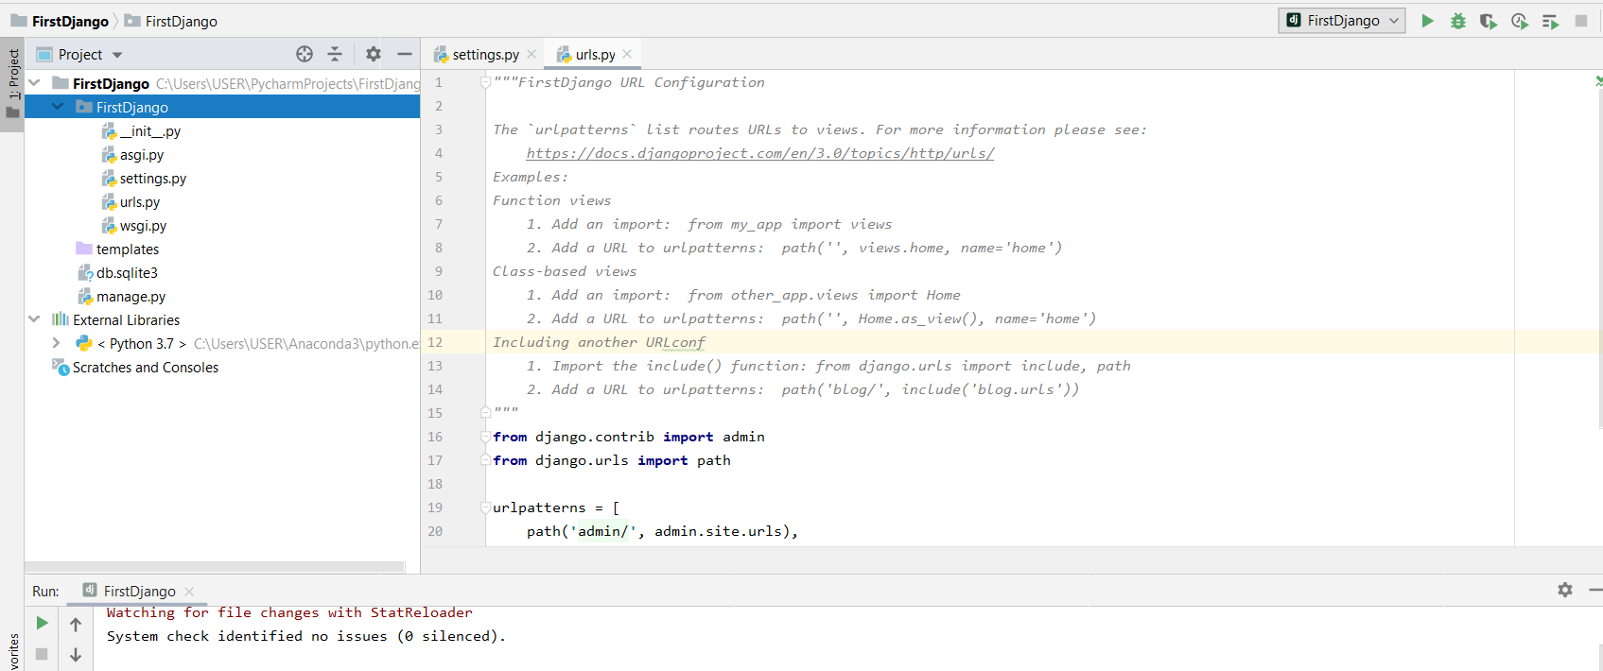
1st example
The first environment is shown below
To start the first Django, click “Start”

Slide 14
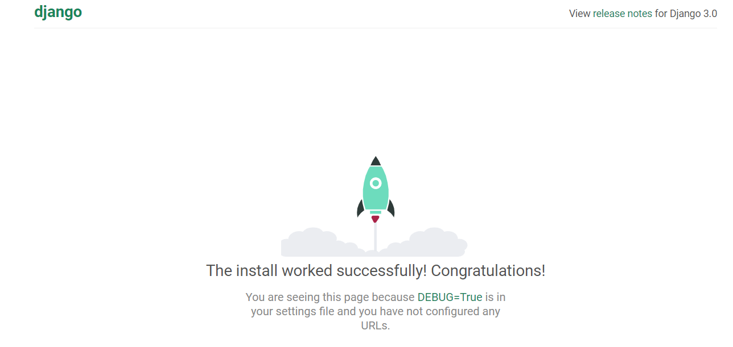
1st example
Run Django
http://127.0.0.1:8000/

Slide 15
Summary
We learnt the “Hello World” in the Django using PyCharm environment
Next, we will learn more about Django Template

